Slide 1
SE 577 Software Architecture Architectural Styles

Slide 2
Acknowledgement
Material from several sources including:
D. Garlan and M. Shaw, “An Introduction to Software Architecture”, CMU-CS-94-166
R.N. Taylor, N. Medvidovic, and E.M. Dashofy. Software Architecture: Foundations, Theory and Practice, Wiley.
Farshidi, Jansen, and van der Wolf. Capturing software architecture knowledge for pattern-driven design. Journal of Systems and Software, 2020
Erder, Pureur, and Woods. Continuous Architecture in Practice
Richards and Ford. Fundamentals of Software Architecture
Carvantes and Kazman. Designing Software Architectures

Slide 3
Software Architecture - Ingredients
Most definitions of software architecture generally talk about
What are the important “architectural” components
What are the connectors between the architectural components
What patterns, constraints, or decisions govern the restrictions on connecting the architectural components.
Think about it, not all ways to connect architecture components together are equally good.

Slide 4
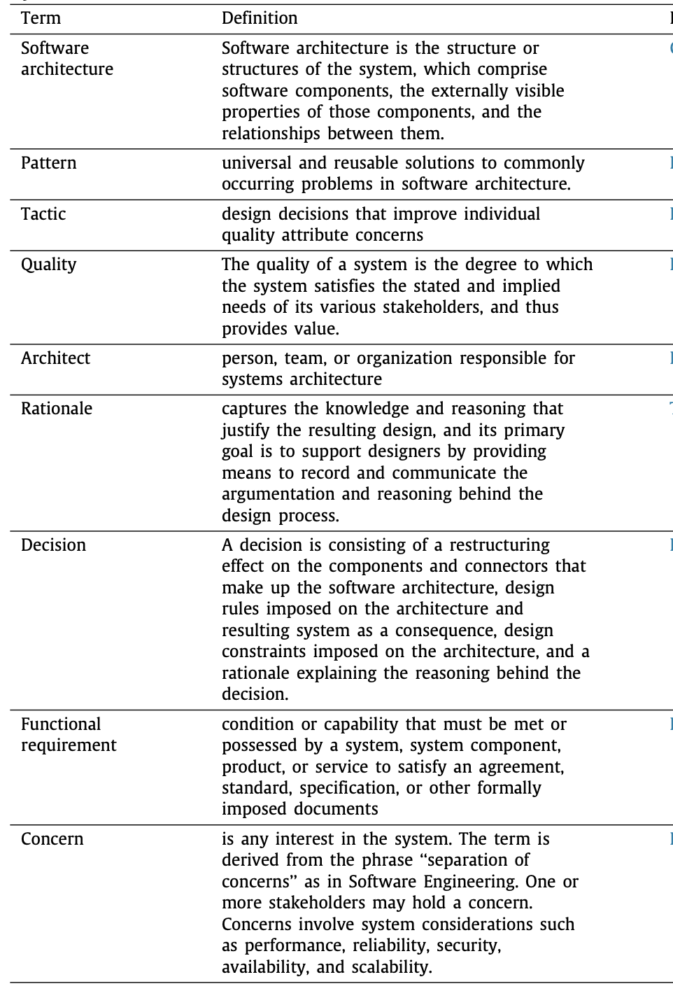
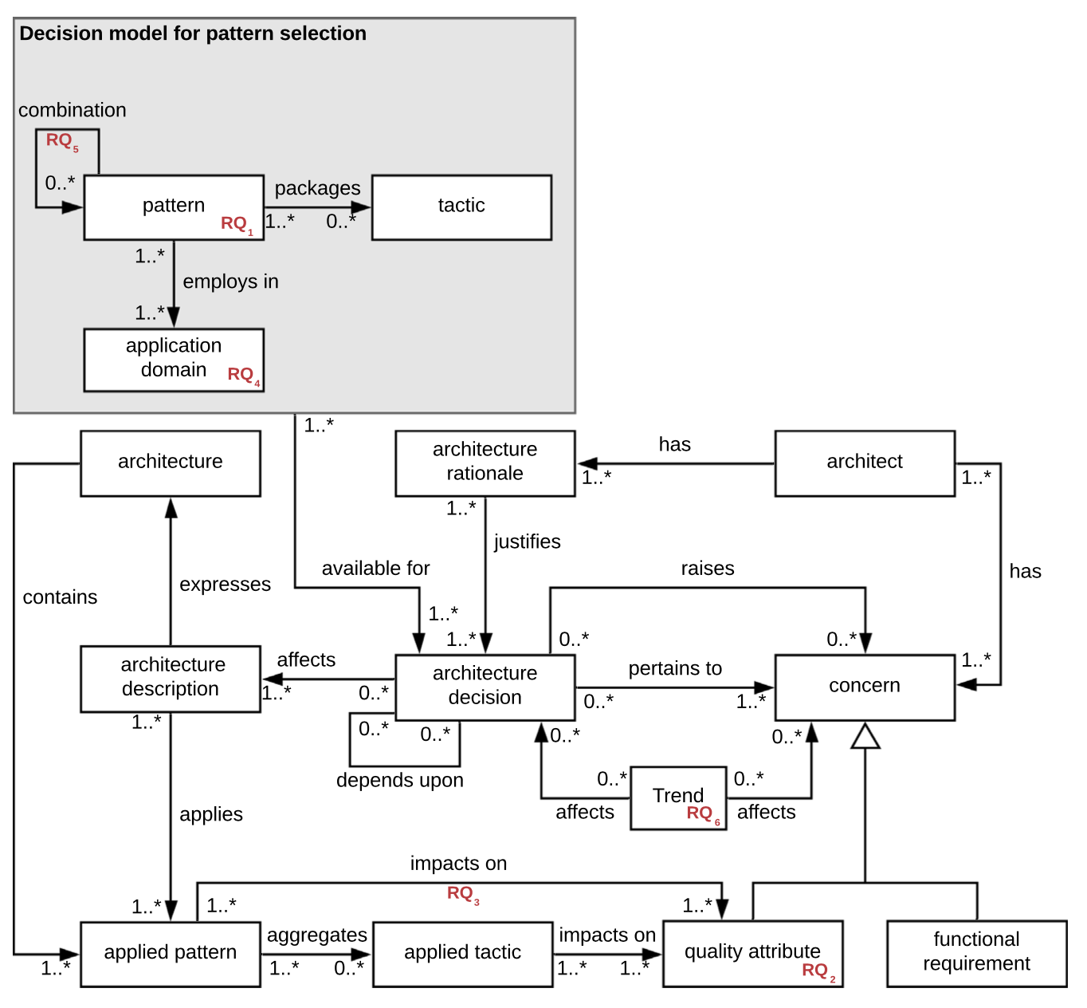

Architecture as an Algorithm
https://www.iso.org/obp/ui/#iso:std:iso-iec-ieee:42020:ed-1:v1:en

Slide 5
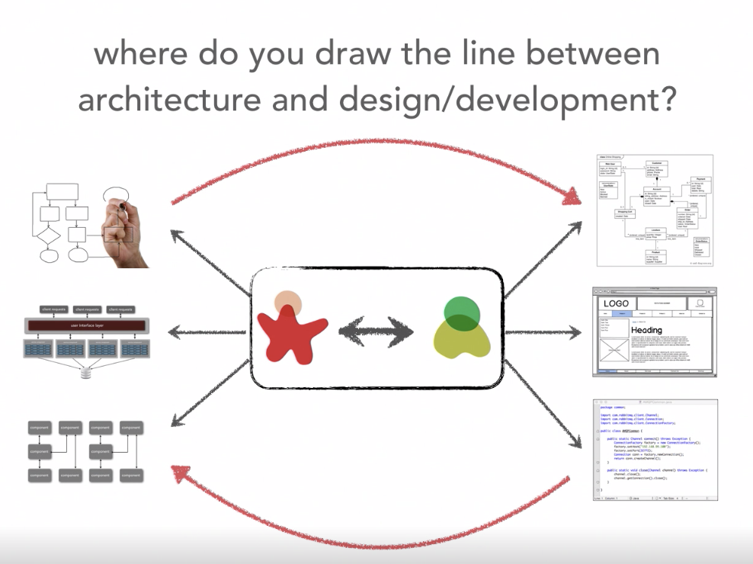

We can also look at this non- hierarchical… The relation between the architecture and design spaces
Ref: Neil Ford & Mark Richards Software Architecture Fundamentals
Bi-Directional Influence
Architecture Stuff
Design Stuff
Constituent Collaboration

Slide 6
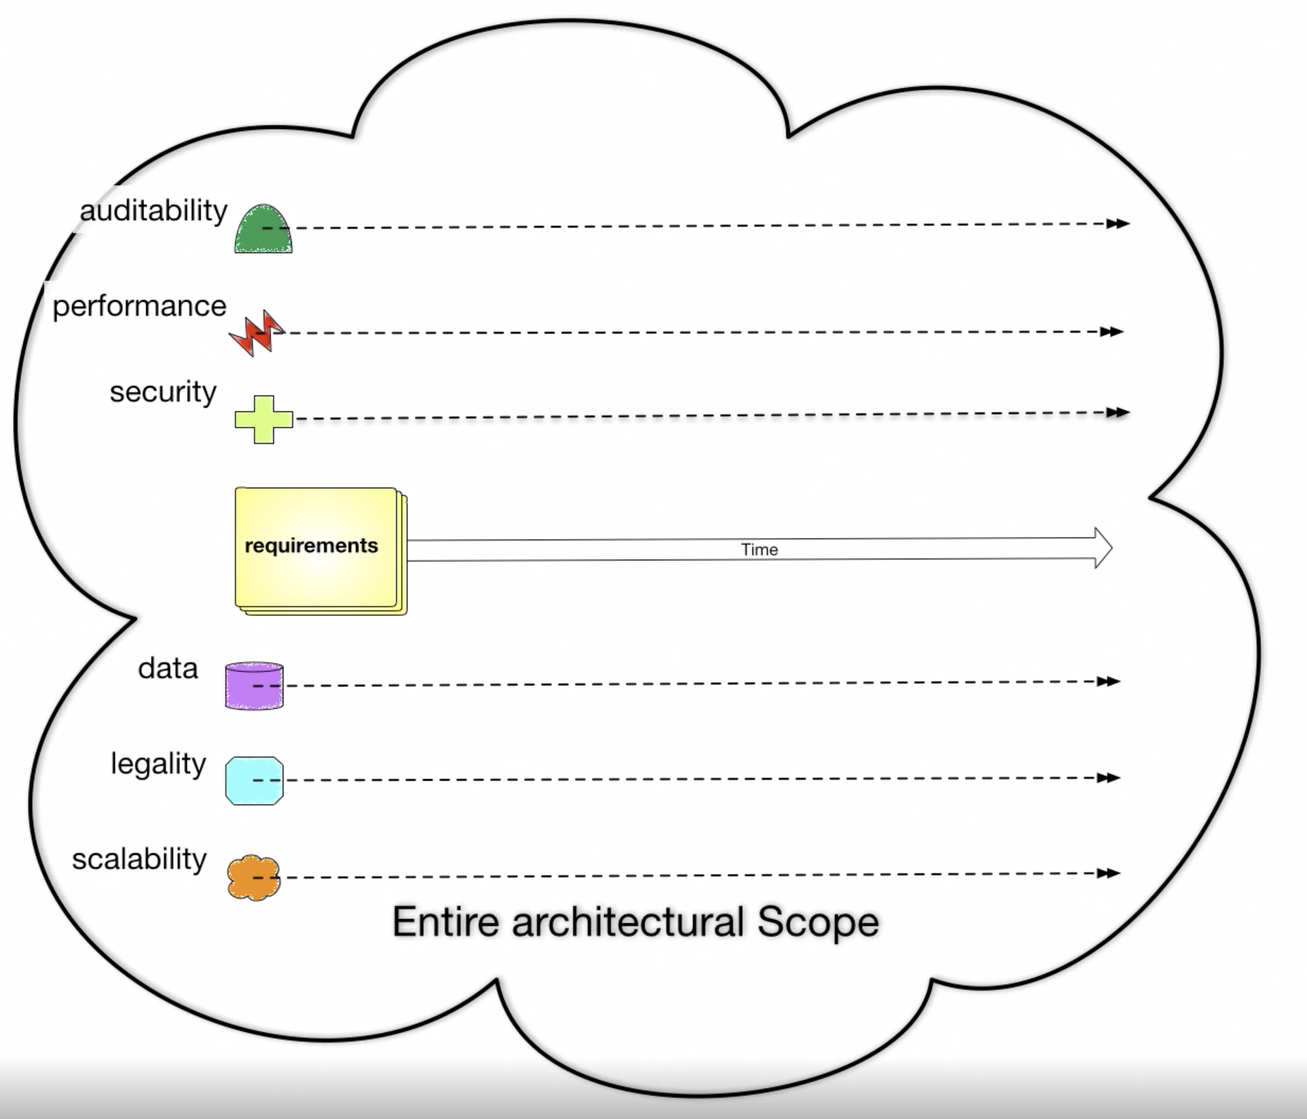
Architecture has a broader scope than design
Ref: Neil Ford & Mark Richards Software Architecture Fundamentals
Broader Architecture Focus
Design Focus

Slide 7
System Quality Attributes
Ref: https://en.wikipedia.org/wiki/List_of_system_quality_attributes
accessibility
accountability
accuracy
adaptability
administrability
affordability
agility
auditability
autonomy
availability
compatibility
composability
configurability
correctness
credibility
customizability
debugability
degradability
determinability
demonstrability
dependability
scalability
seamlessness
self-sustainability
serviceability securability
simplicity
stability
standards compliance
survivability
sustainability
tailorability
testability
timeliness
traceability
transparency
ubiquity
understandability
upgradability
vulnerability
usability
deployability
discoverability [Erl]
distributability
durability
effectiveness
efficiency
evolvability
extensibility
failure transparency
fault-tolerance
fidelity
flexibility
inspectability
installability
integrity
interchangeability
interoperability [Erl]
learnability
maintainability
manageability
mobility
modifiability
modularity
operability
orthogonality
portability
precision
predictability
process capabilities
producibility
provability
recoverability
relevance
reliability
repeatability
reproducibility
resilience
responsiveness
reusability [Erl]
robustness
safety
These attributes and the tradeoffs associated with them influence architecture and design decisions

Slide 8
System Quality Attributes
Ref: https://en.wikipedia.org/wiki/List_of_system_quality_attributes
Although there are many quality attributes, certain ones tend to appear again and again that impact the design and architecture of systems
Modularity
Maintainability
Testability
Availability
Deployability
Reliability
Scalability
Evolvability
Affordability
++ FEASIBILITY ++

Slide 9
Blockchain Demo – Quality Attributes and Architecture & Design
Kubernetes
Blockchain UI Pod
Blockchain UI Service
container
Localhost:30133
/
GoLang Solver API Pod
GoLang Solver Service
/api/go
container
Browser
/api/node
NODE Solver Service
NODE Solver API Pod
HA Proxy Ingress Controller
/api/kotlin
container
Kotlin Solver Service
Kotlin Solver API Pod
/api/rust
container
RUST Solver Service
RUST Solver API Pod
container

Slide 10
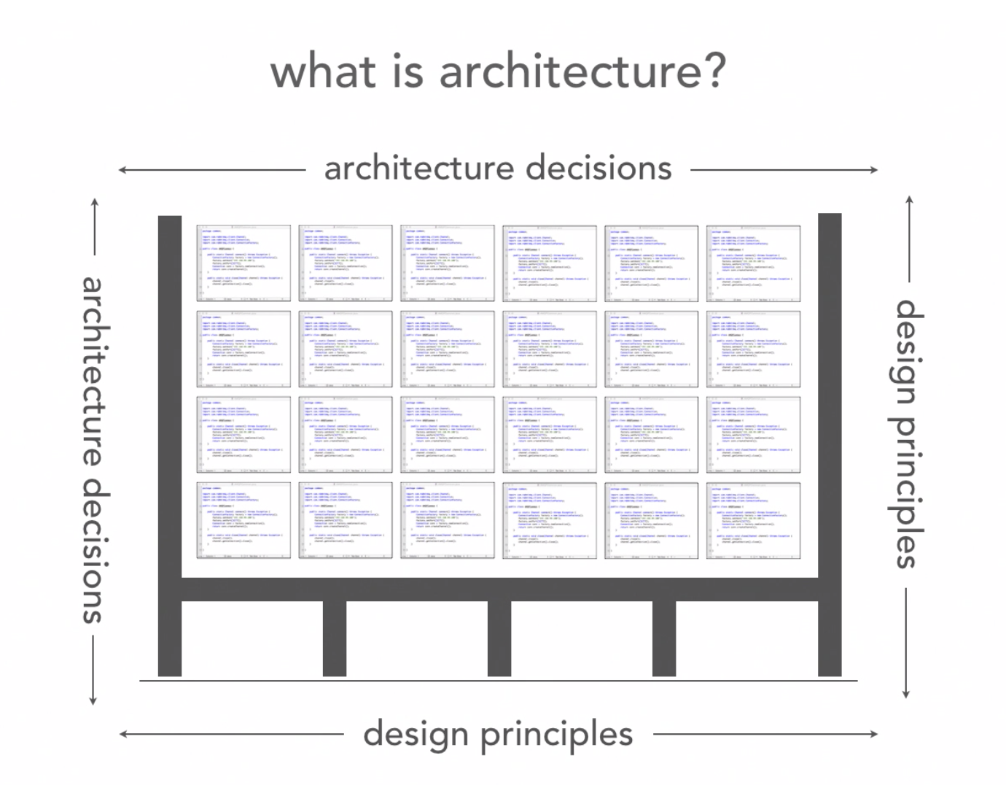
The structure of the source code should not be determined arbitrarily
Ref: Neil Ford & Mark Richards Software Architecture Fundamentals
What holds up the source code structure?

Slide 11
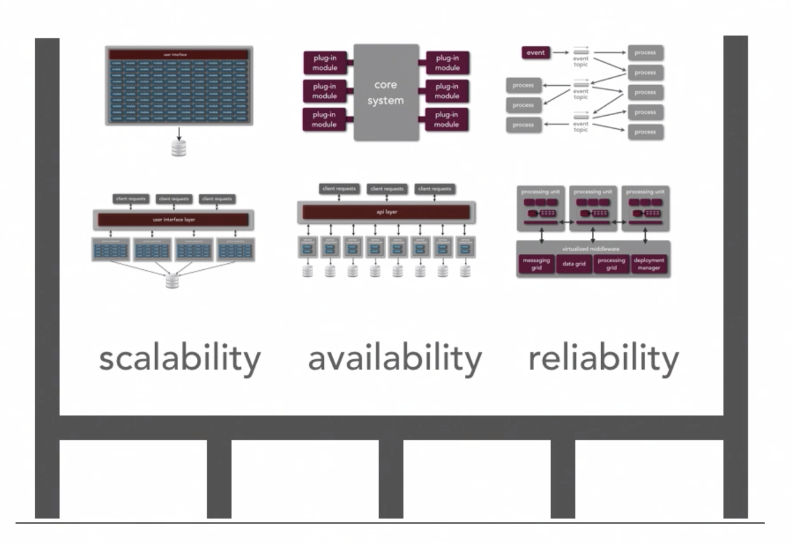
Starting with understanding the structure of the system
Ref: Neil Ford & Mark Richards Software Architecture Fundamentals
We can use architecture styles and patterns to structure the system
Needed quality attributes will also help dictate the system structure

Slide 12
Back to Architecture Basics
When I introduced the vocabulary of architecture components
Terms used: Components, Connectors, Structures, and so on.
I like to think about architecture in terms of laying out the foundation for design
What design decisions do we need to make, and/or what structures do we need to document in order to realize all of the constraints imposed on the system
Constraints typically come from the non-functional requirements – time to market, budget, technology standards, skillsets, etc
Good architecture makes important decisions early and defers less-important decisions to later
Do we really need to pick the database technology up front?
How much should the fact that the system is web-based influence the overall design, can we abstract this for now and specify it later?

Slide 13
DRAFT – Types of Architects
SOFTWARE ENGINEER
(EXPERT BUILDER)
PRODUCT SPONSOR
(DEFINE THE WHAT, $$$$)
A GOOD ARCHITECT
SOFTWARE ENGINEER
(EXPERT BUILDER)
PRODUCT SPONSOR
(DEFINE THE WHAT, $$$$)
ARCHITECT in Training
|
Soft Skills Development Mentoring
SOFTWARE ENGINEER
(EXPERT BUILDER)
PRODUCT SPONSOR
(DEFINE THE WHAT, $$$$)
X
A Wikipedia ARCHITECT
PROJECT MGR
SOFTWARE ENGINEER
(EXPERT BUILDER)
PRODUCT SPONSOR
(DEFINE THE WHAT, $$$$)
X
ARCHITECT Actor
X
PROJECT MGR

Slide 14
Architecture and Design Patterns
Architecture Style
Defines the vocabulary of the components and connectors in a software architecture and the constraints on how they can be combined.
Example: Pipe and Filter
Architecture Patterns
Focus is on the organization of the overall system
An instance of an architecture style
Example: Model-View-Controller (MVC)
Design Patterns
Focus is on the organization of a block of code

Slide 15
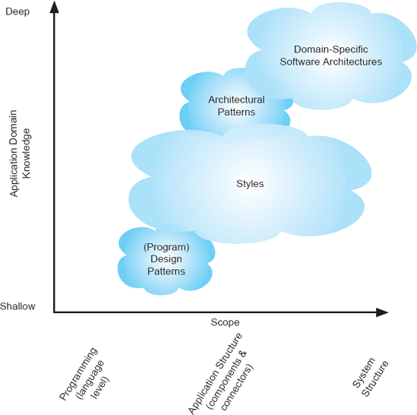
Software Architecture Landscape
Also known as a reference architecture, is the set of principal design decisions that are simultaneously applicable to multiple related systems, typically within an application domain, with explicitly defined points of variation
An architectural pattern is a named collection of architectural design decisions that are applicable to a recurring design problem, parameterized to account for different software development contexts in which that problem appears.
.
An architectural style is a named collection of architectural design decisions that (1) are applicable in a given development context, (2) constrain architectural design decisions that are specific to a particular system within that context, and (3) elicit beneficial qualities in each resulting system.
R.N. Taylor, N. Medvidovic, and E.M. Dashofy. Software Architecture: Foundations, Theory and Practice, Wiley.

Slide 16
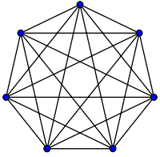
Remember every system has an architecture – Our first architecture pattern
Lets call this the “ball of mud” architecture pattern – it meets the definition Constraints of this pattern – every component is allowed to directly talk to every other component – in other words – there are no constraints Thus, introducing a new component, allows for an additional n-1 connections where n is the total number of components

Slide 17
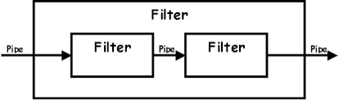
Another Architecture Pattern – this one a little more realistic
The Pipe-and-Filter is a classic architecture pattern – its actually the basis for some of the goodness in functional programming and other design patterns such as the builder pattern
Components are the filters – all inputs are provided by pipes, all transformations are done by filters. Filters are stateless, all transformations are based on pipe inputs
The filters can ingest inputs and produce outputs atomically or via streaming

Slide 18
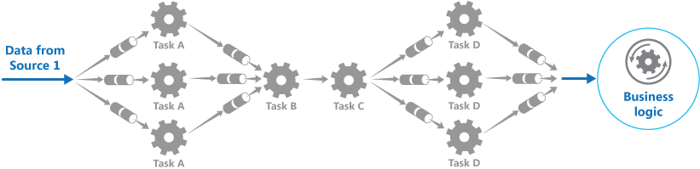
Another Architecture Pattern – this one a little more realistic
The Pipe-and-Filter is also powerful because there can be special filters that split data and other filters that coordinate merging of data
This enables large scale and concurrency more likely parallelism

Slide 19
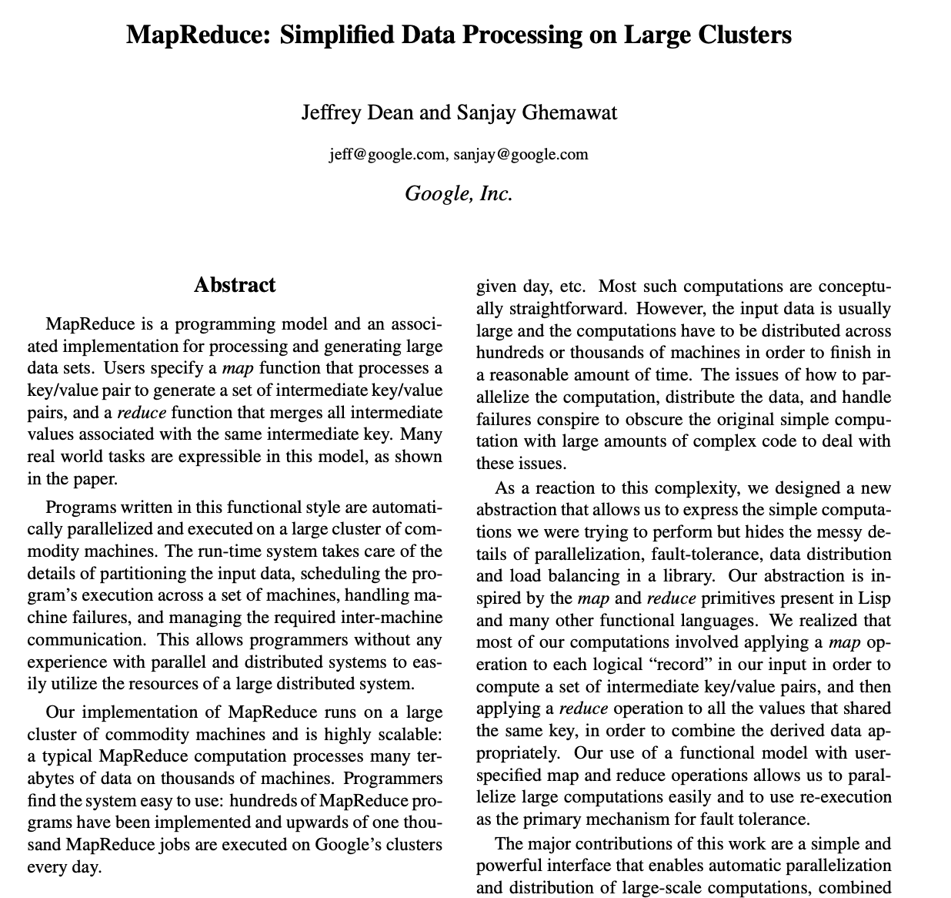
Pipe and Filter is very useful in the real world
This is the seminal paper by google on MapReduce – basically an at scale implementation of pipe-and-filter

Slide 20
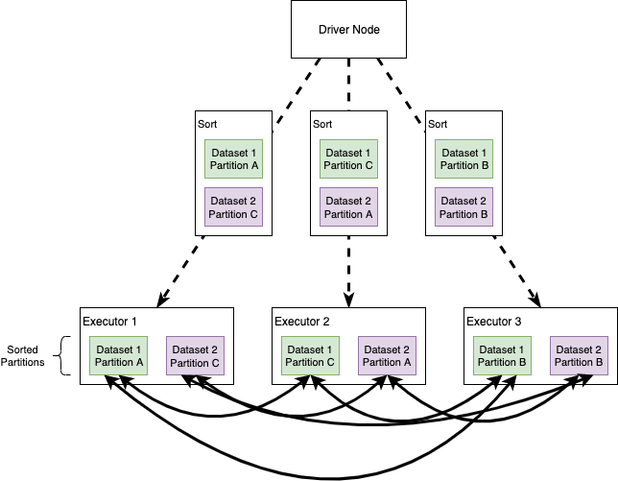
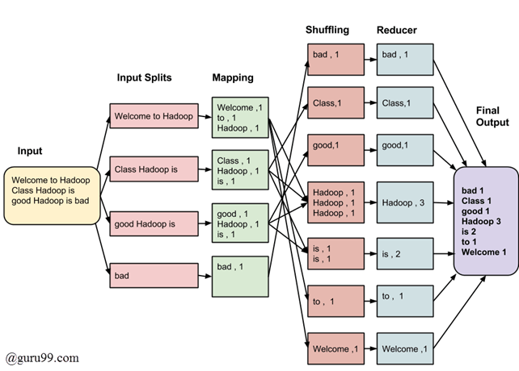


Pipe-and-Filter used as at scale data pipelines

Slide 21
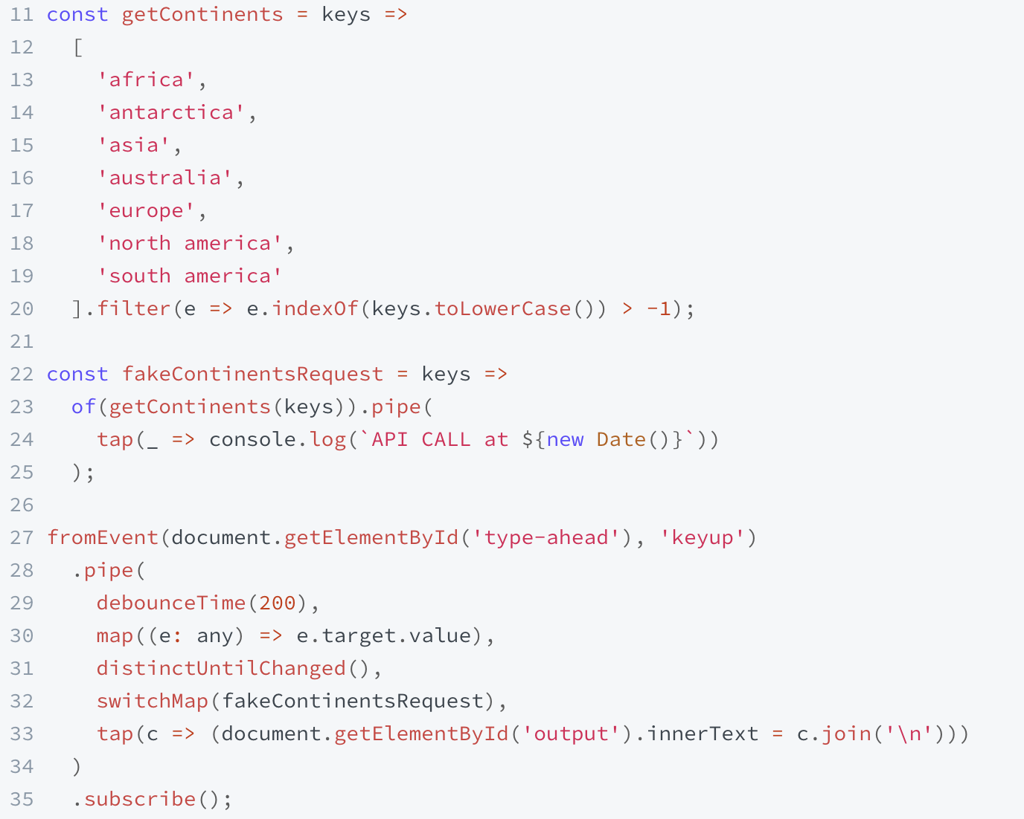
Pipe-and-Filter – Functional Programming
Demo at: https://www.learnrxjs.io/learn-rxjs/recipes/type-ahead

Slide 22
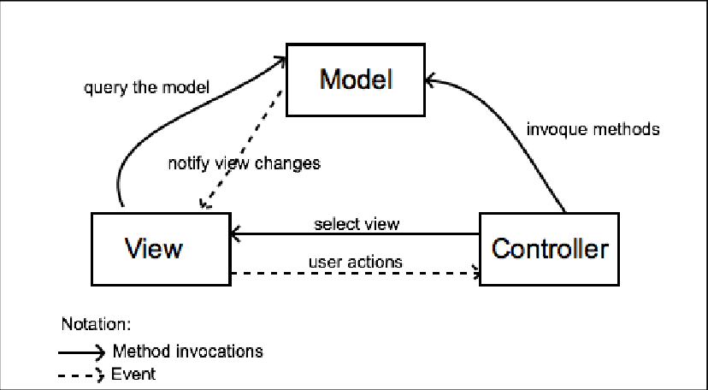
An example of an architecture “style” – MVC (Model/View/Controller)
MVC is a more realistic example of an architecture style
View is passive, reacts to changes – updates data based on model events, updates presentation based on controller reacting to user behavior
Application state fully managed by model

Slide 23
Sidebar – Architecture Style versus Architecture Pattern?
If you study classic references for software architecture you will see that architecture styles and patterns are considered different things…
While we can form a general understanding of their differences based on abstraction (e.g., pipe/filter vs MVC)…
In practice, they can generally be used interchangeably – Ill generally just call them architecture styles

Slide 24
Architecture Styles
Architecture Styles Define and Constrain the:
The components of the solution
What are the major computational units of the solution
Eg., Security, Data Access, Protocol Handling, …
The connectors of the solution
How are the interactions between the components realized
Eg., procedure calls, network calls, events, broadcasts, …
The properties of the solution
What are the quality attributes and non-functional requirements
Eg., pre/post conditions, availability specifications, interface semantics, …

Slide 25
Architecture decisions and design principles also influence the system structure
Ref: Neil Ford & Mark Richards Software Architecture Fundamentals
Things that make the solution performant, scalable, modular, maintainable, testable, and so on
Things that make the code performant, scalable, modular, maintainable, testable, and so on

Slide 26
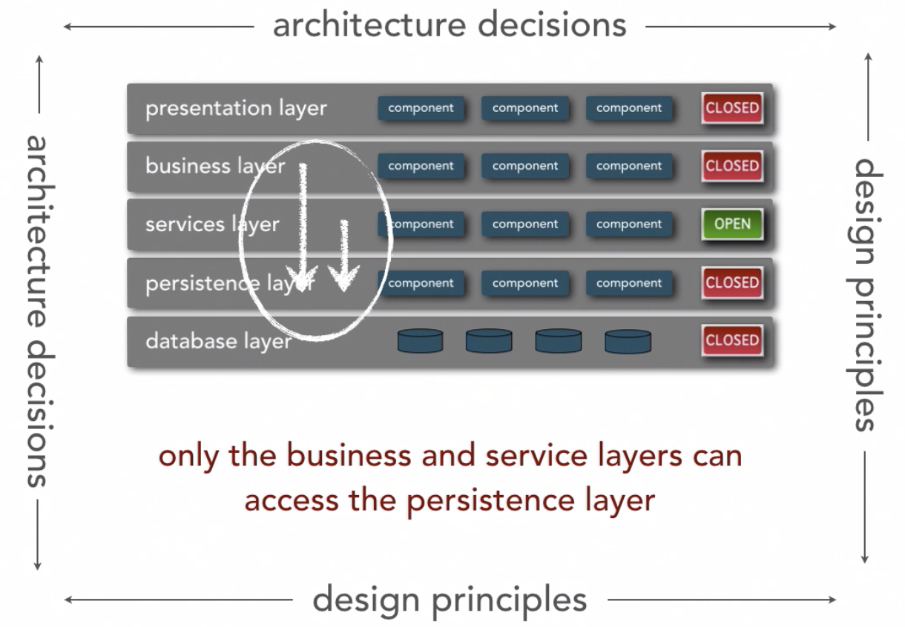
Architecture principal example
Ref: Neil Ford & Mark Richards Software Architecture Fundamentals
We don’t introduce layers for the purposes of just having a layer that does not add any value
Reduces coupling by only allowing components to communicate to adjacent layers or within the same layer

Slide 27
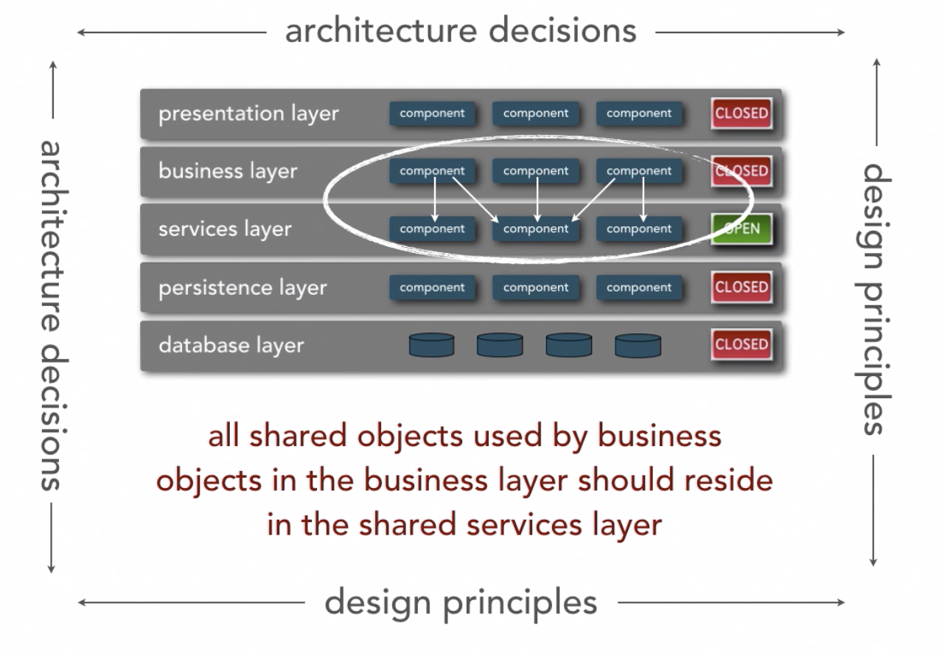
Another architecture principal example…
Ref: Neil Ford & Mark Richards Software Architecture Fundamentals
Implies reuse emphasis will be in the services layer

Slide 28
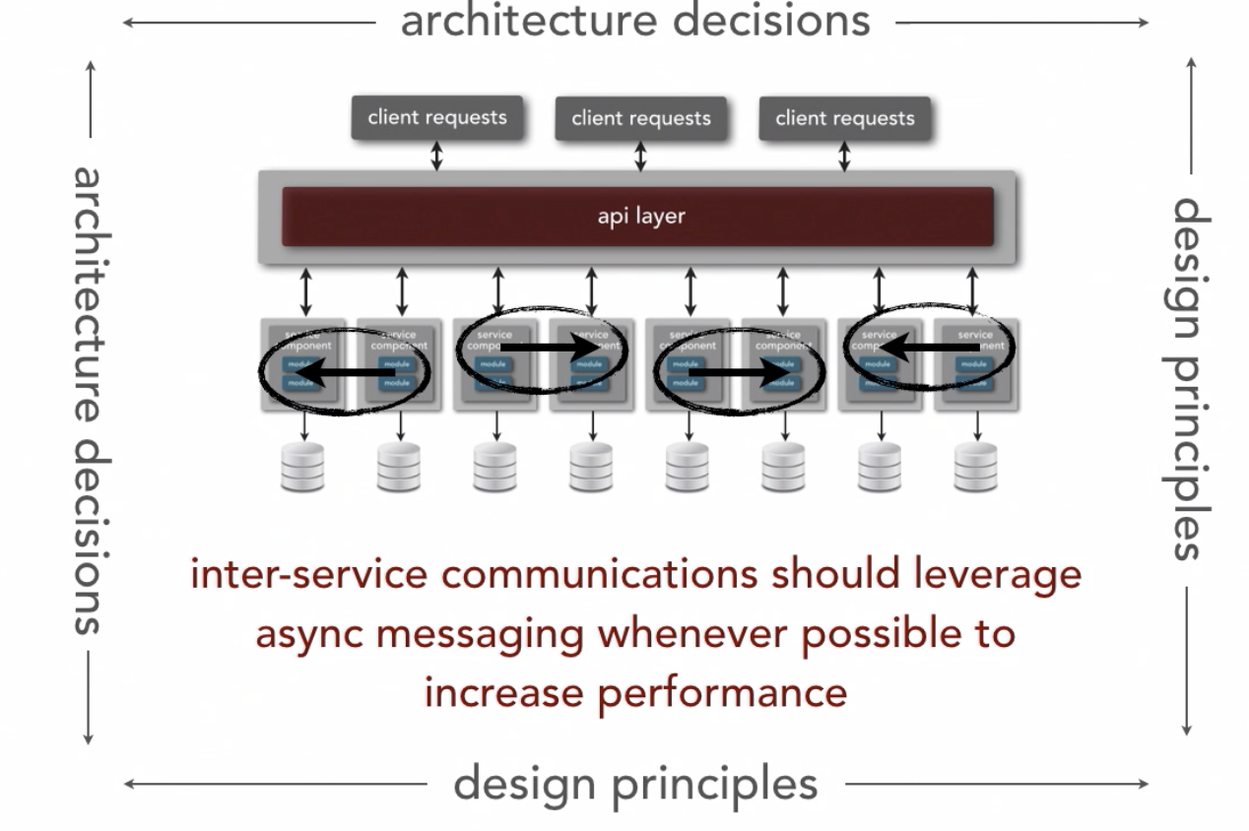
Design principles can impact many platform and technology aspects
Ref: Neil Ford & Mark Richards Software Architecture Fundamentals
A design decision that has been shown to have good performance characteristics…
Tradeoff is introduction of complexity

Slide 29
Back to Architecture
The previous definitions presented focus on the vocabulary of architecture components
Terms used: Components, Connectors, Structures, and so on.
I like to think about architecture in terms of laying out the foundation for design
What design decisions do we need to make, and/or what structures do we need to document in order to realize all of the constraints imposed on the system
Constraints typically come from the non-functional requirements – time to market, budget, technology standards, skillsets, etc
Good architecture makes important decisions early and defers less-important decisions to later
Do we really need to pick the database technology up front?
How much should the fact that the system is web-based influence the overall design, can we abstract this for now and specify it later?

Slide 30
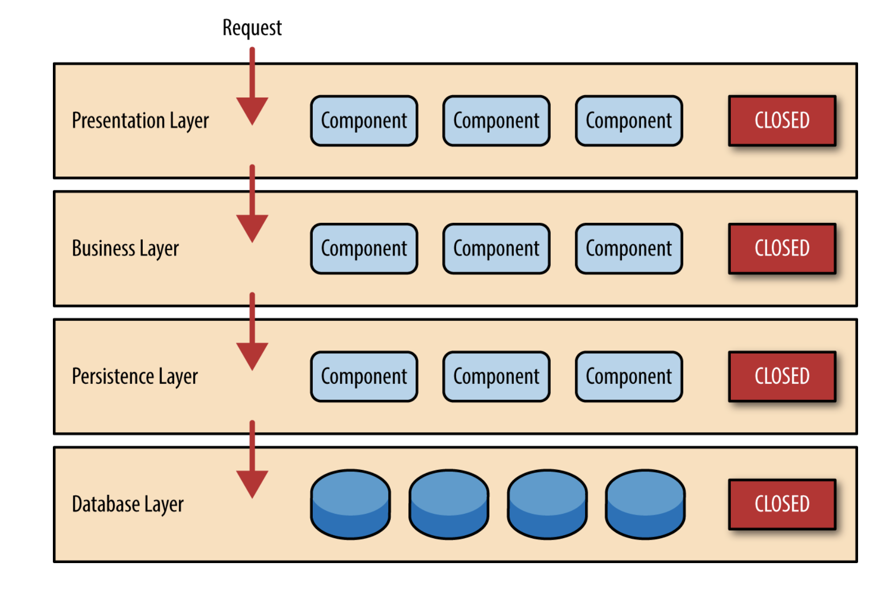
Layered Style
Basic Principle is that you can only interact in one direction with an adjacent layer

Slide 31
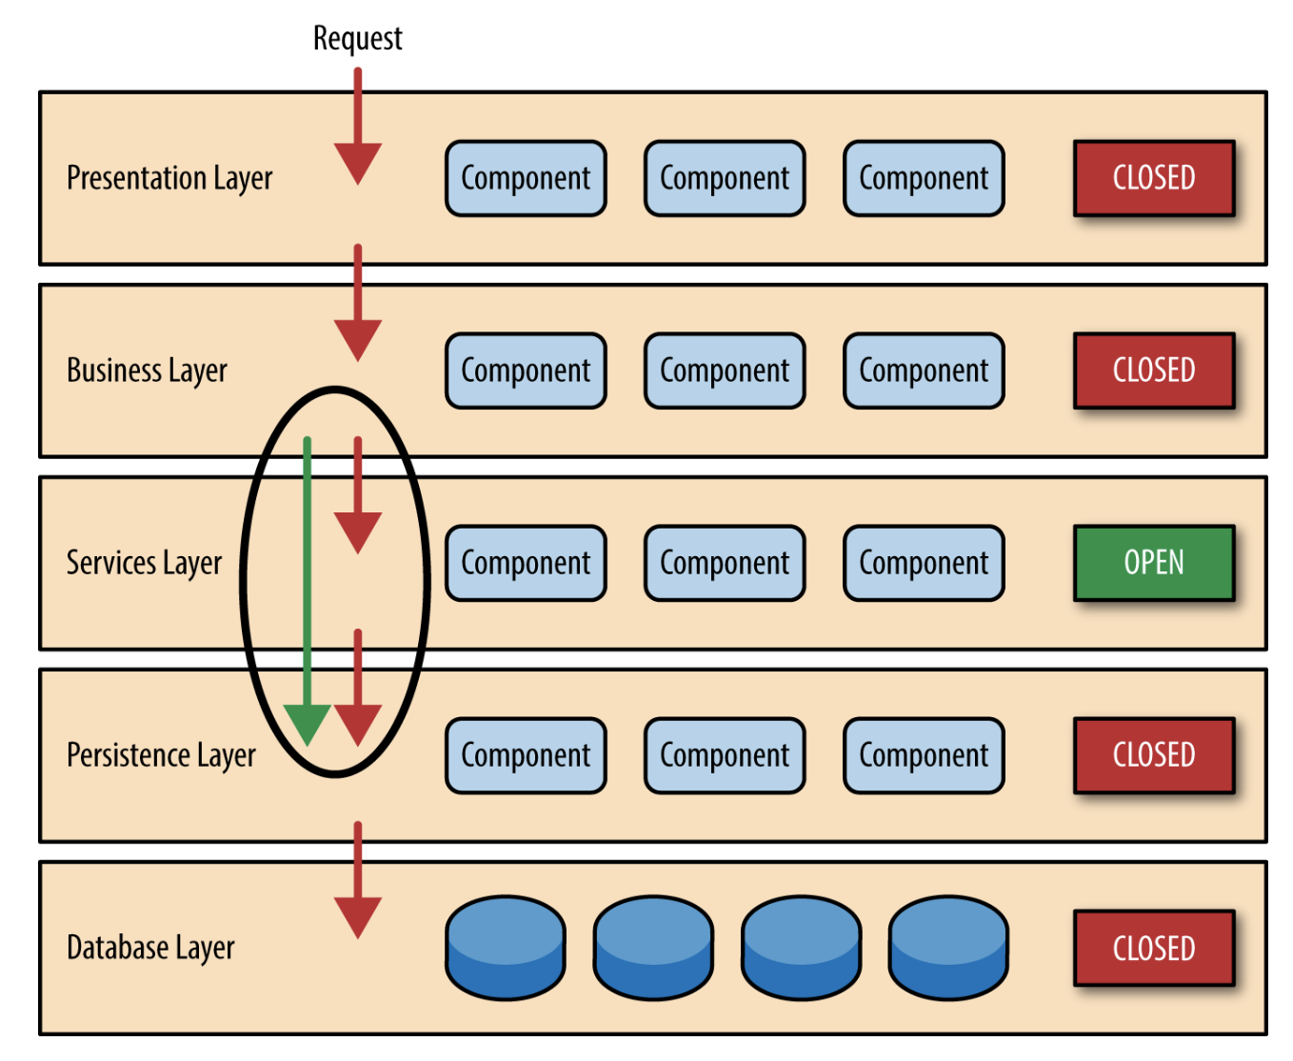
Layered Style
Sometimes Layers are Open To Bypassing

Slide 32
Pipe and Filter
The pipe & filter architecture style is used to wire together processing components
Producer
Starting component, initiates activity
Transformer
Input, Processing, Output
Observer
Input, Discard, Pass-through
Splitter
Input, Optional Processing, Multiple Outputs
Merger
Collect Multiple Inputs, Process, Output
Consumer
Ending component, stop here

Slide 33
Pipe and Filter
The pipe & filter architecture style is used to wire together processing components
Language Serializer
Service Definition
Service Compiler
Language Deserializer
Java Object
Java Serializer
Node Object
JavaScript Serializer
Network Writer
Network Reader
Python Deserializer
GoLang Struct
GoLang Serializer
Python Object

Slide 34
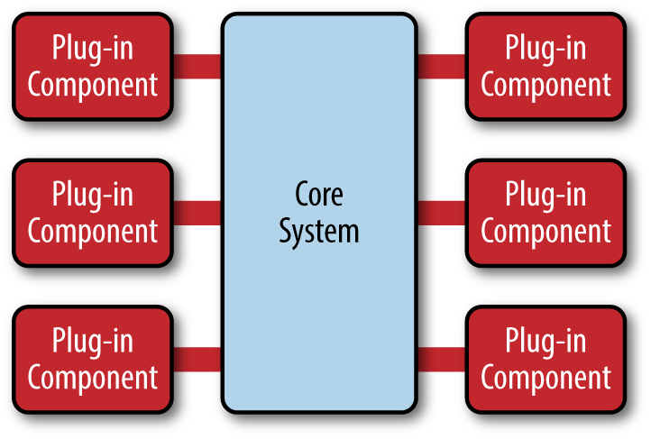
Microkernel Architecture Style
A common architecture style for Software as a Service solutions
The “Core System” provides the value added functionality out of the box The “Plug In Component” can be other purchased software specific to an industry vertical (e.g., healthcare, telecom, etc), or custom code taylored to a specific need.
Often-times the core system will prove an API or SDK to enable the plug-in ecosystem

Slide 35





Microkernel Architecture Style - Examples

Slide 36
Event Architectures – Event Notification
Event ”React To Something” “noop”
What Happened
S1
S2
S3
S4
Publish
Event
Subscribe
Event
e1
Command ”Do Something”
“Something Happened”
Event Notification Loosen coupling with pub/sub patterns
Interest is only in if the event has occurred
Semantics of the event and how to react to it…
Source: The Many Meanings of Event-Driven Architecture – Martin Fowler

Slide 37
Event and Streaming Architectures
S1
S2
S3
S4
Publish
Event
Subscribe
Event
e1
Before State After State
Event Carried State Transfer Loosen coupling with pub/sub patterns
Eventual Consistency
Source: The Many Meanings of Event-Driven Architecture – Martin Fowler

Slide 38
Event – Event Carried State Transfer
(2) Notify Event
S1
S2
S3
S4
(3) Update App State
(1) Publish
Event
e5
Event Store
Before State After State
e1
e2
e3
e4
Event Sourcing Event Store Maintains State Over Time
Loosens Coupling
Source: The Many Meanings of Event-Driven Architecture – Martin Fowler

Slide 39
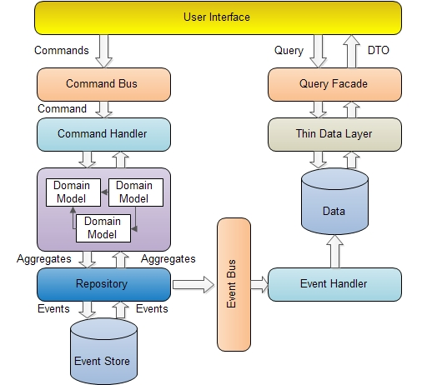
Event – Command Query Responsibility Separation
Writes
Reads
Scalability and Consistency via Separate Handling of Reads and Writes (CQRS)

Slide 40
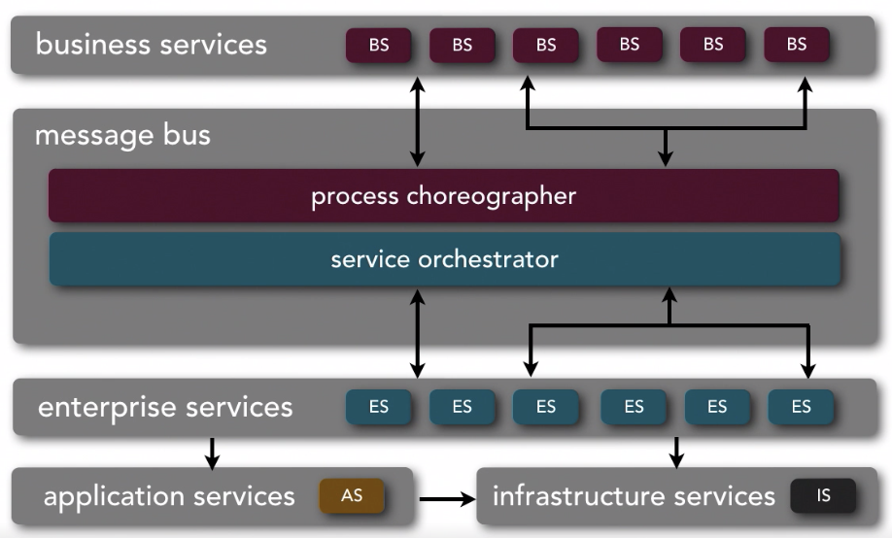
Service Oriented Architecture Style
Applications use the Business Services
Ref: Neil Ford & Mark Richards Software Architecture Fundamentals
Bottleneck VERY difficult to maintain
Why would you think this is fragile?
Productized as Enterprise Service Buses (ESBs)
Legacy
ERP
Thoughts? Good Parts? Bad Parts?

Slide 41
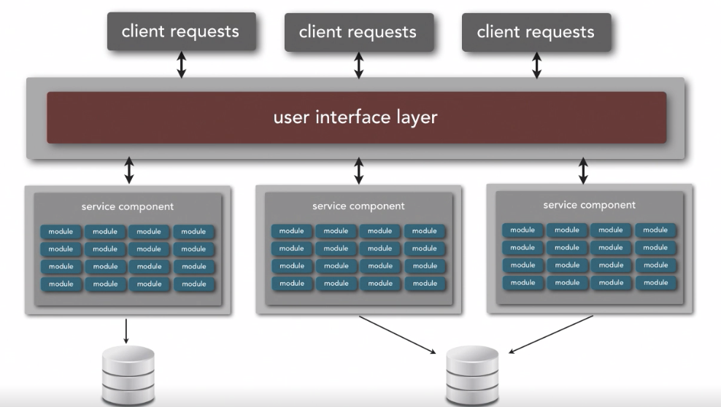
Service Based Style
Ref: Neil Ford & Mark Richards Software Architecture Fundamentals
http or grpc
http or grpc
http or grpc
API GATEWAY
FRONT END FOR BACKEND
http or grpc
http or grpc
http or grpc
API GATEWAY
Works Well To Partition Functionality

Slide 42
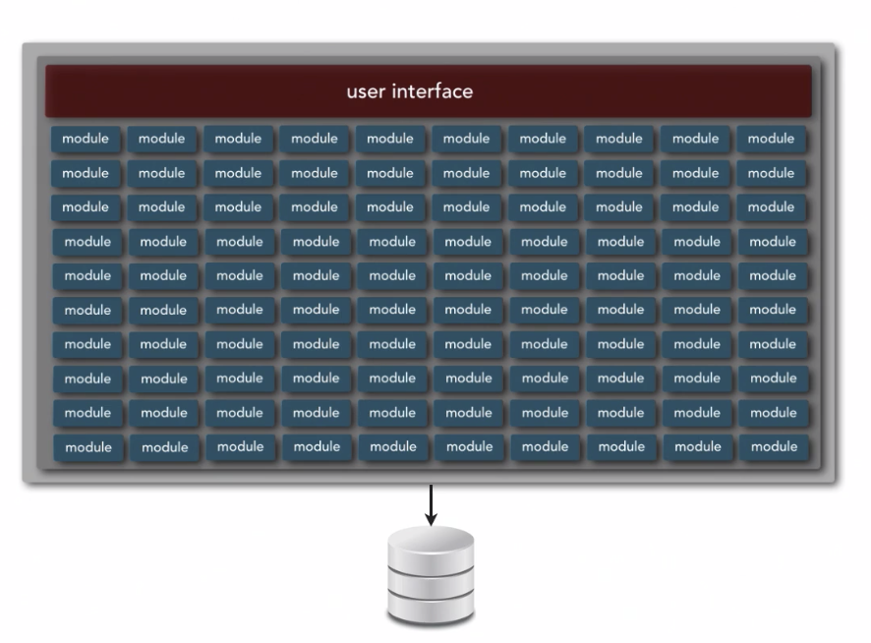
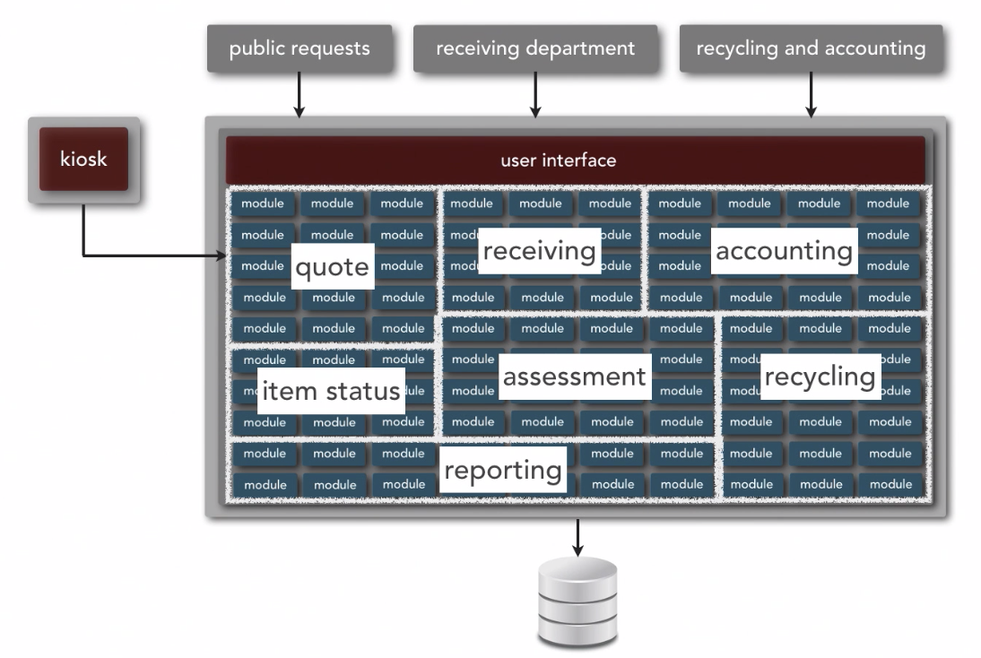
Service Based Style - Example
Ref: Neil Ford & Mark Richards Software Architecture Fundamentals
Generally Good To Decompose a Monolithic Application

Slide 43
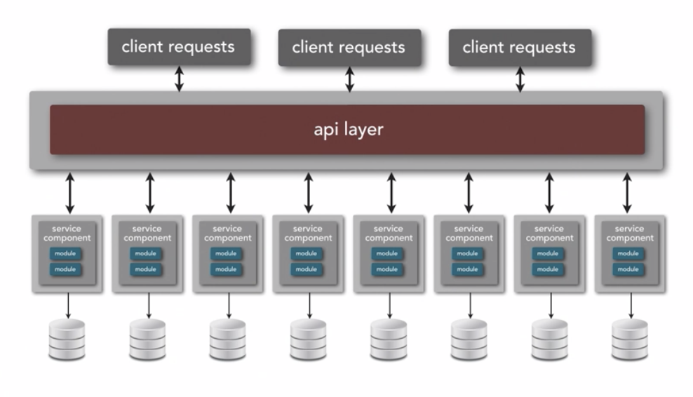





Microservice Architecture
But they can get so complex that the only thing that can manage them is automation and very specialized tooling (e.g., Service Mesh)
Ref: Neil Ford & Mark Richards Software Architecture Fundamentals
API GATEWAY e.g, Kong Gloo
Service Mesh e.g, Kong Gloo
Communication Generally using Events / Streaming
MAIN Idea – SHARE NOTHING

Slide 44
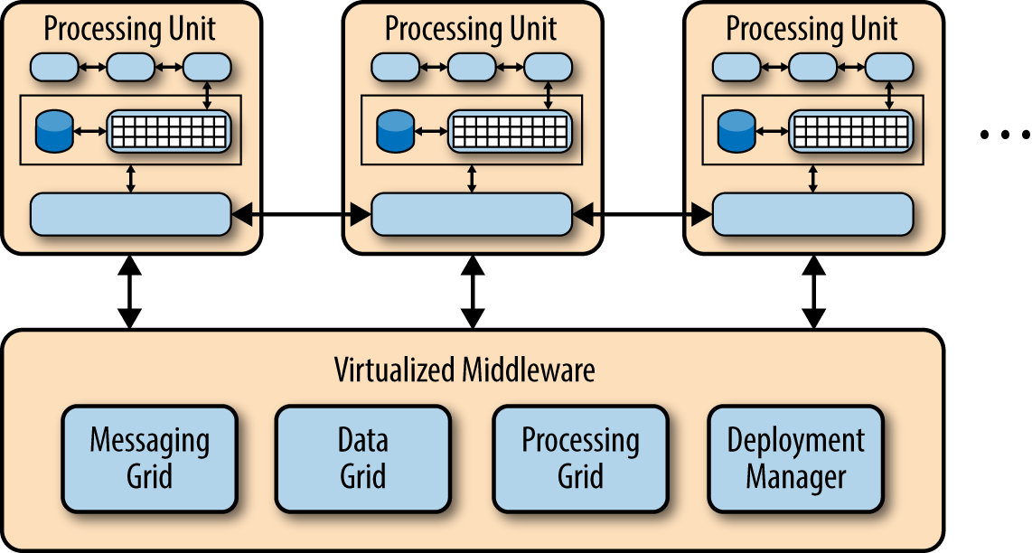

Space-Based Architecture (aka Cloud)
Ref: Neil Ford & Mark Richards Software Architecture Fundamentals
Basic Idea – Minimize Factors that Limit Scaling

Slide 45
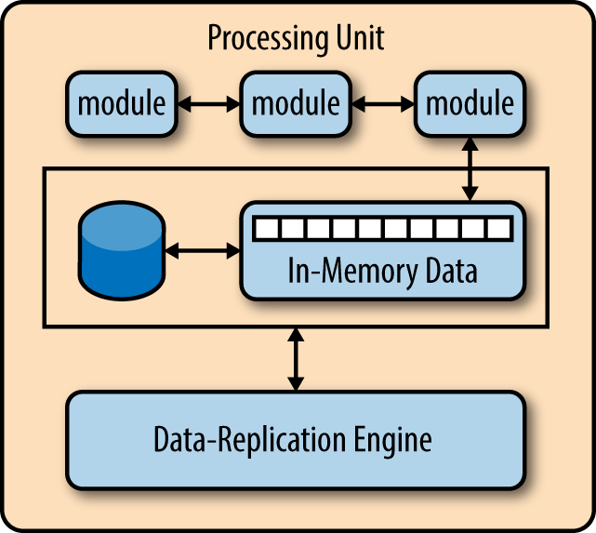
Space-Based Architecture– Key Components
Ref: Neil Ford & Mark Richards Software Architecture Fundamentals
The virtual middleware connects to all processing units
Messaging Grid: Behaves like a smart load balancer, intelligently routing messages to processing units
Data Grid: Works with the data replication components in each processing unit to make sure the right data is replicated to the right Processing Unit and kept coherent
Processing Grid: Mediates and orchestrates distributed work that is executed on multiple processing units
Deployment Manager: Ensures the right code is deployed to the right processing unit as well as handling scaleup and scale down
The processing unit provides a virtualized environment that enables modules to have everything that they need appear to be local
Basic Idea – Minimize Factors that Limit Scaling

Slide 46
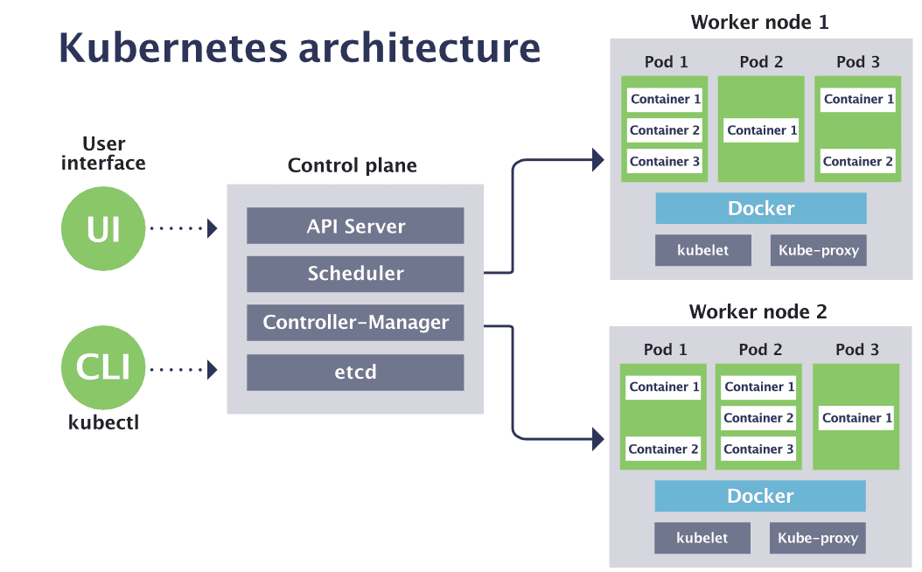
Space-Based Architecture– Example: Kubernetes

Slide 47
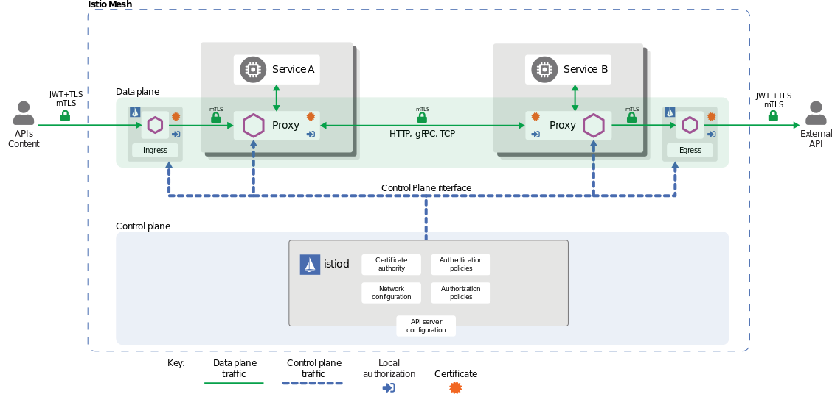
Space-Based Architecture– Example: Service Mesh on Kubernetes

Slide 48
Architecture is a design activity
A software design is not necessary for trivial systems, but for large systems a design based on a strong software architecture is essential.
Manage complexity
Validation of delivered software
Simplify future maintenance
A mechanism for communication between domain experts and technical professionals
Enables Visualization
Enables project team members to work concurrently
Partitioning the work effort with limited overlap
Example: Concurrently developing test cases while the code is being development
A foundational understanding of software architecture patterns and styles is important, but structuring the architecture is a design activity and not a leggo-block or paint by numbers activity

Slide 49
Why is design so hard…
Software design can’t be taught, but principles of good design can
There are degrees of good and bad design, but its hard to say if a design is correct or not
The underlying assumptions and requirements that support the design change
A design is like wine, it takes a long time to see if it is good or not
Whole body of architecture work around the concept of “technical debt” -> technical debt is often depicted as bad, I argue that systems that we say have technical debt generally were built with a good design.

Slide 50
The Process of Design
Definition:
Design is a problem-solving process whose objective is to find and describe a way:
To implement the system’s functional requirements...
While respecting the constraints imposed by the quality, platform and process requirements...
including the budget
And while adhering to general principles of good quality

Slide 51
Design as a series of decisions
A designer is faced with a series of design issues
These are sub-problems of the overall design problem.
Each issue normally has several alternative solutions:
design options.
The designer makes a design decision to resolve each issue.
This process involves choosing the best option from among the alternatives.
To make each design decision, the software architect uses:
Knowledge of
the requirements
the design as created so far
the technology available
software design principles and ‘best practices’
what has worked well in the past

Slide 52
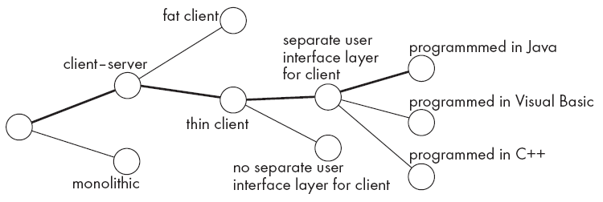
Design space
The space of possible designs that could be achieved by choosing different sets of alternatives is often called the design space
For example:

Slide 53
Design space – Event Based Architecture
Payment Processor
Order Entry
Payment Processor
System
Process Payment
Thoughts on Advantages and Disadvantages of Each Approach?
Order Entry
Payment Processor
Command
Order Entry
Purchase
Payment Processor
Entity
Order Entry
Order Placed
Payment Processor
Event

Slide 54
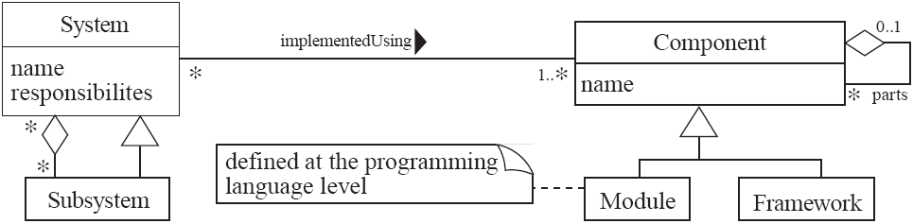
UML diagram of system parts and their relationships

Slide 55
Principles Leading to Good Design
Overall goals of good design:
Increasing profit / reducing cost / increasing revenue / learning opportunity (e.g., open source)
Ensuring that we actually conform with the requirements
Accelerating development
Increasing qualities such as
Usability
Efficiency
Reliability
Maintainability
Reusability

Slide 56
Design Principle 1: Divide and conquer
Trying to deal with something big all at once is normally much harder than dealing with a series of smaller things
Separate people can work on each part.
An individual software engineer can specialize.
Each individual component is smaller, and therefore easier to understand.
Parts can be replaced or changed without having to replace or extensively change other parts.

Slide 57
Ways of dividing things up to manage complexity
A distributed system is divided up into clients and servers
A system is divided up into subsystems
A subsystem can be divided up into one or more packages
A package is divided up into classes
A class is divided up into methods
Try to promote hierarchies

Slide 58
Design Principle 2: Increase cohesion where possible
A subsystem or module has high cohesion if it keeps together things that are related to each other, and keeps out other things
This makes the system as a whole easier to understand and change
Type of cohesion:
Functional, Layer, Communicational, Sequential, Procedural, Temporal, Utility

Slide 59
Design Principle 2: Increase cohesion where possible
Functional | Keeps all code that computes a particular result together
Layer | Facilities for accessing related services are kept together. Hierarchical, you can access layers below but not above
Communicational | Modules that access or manipulate certain data are kept together
Sequential and Procedural | Procedures where one provides input to the next are kept together in a common module. Also procedures that are used one after the next are kept together
Temporal | Operations that are performed at the same phase of execution are kept together (e.g., Initialization)
Utility | Keep related semantic things together, e.g., java.lang.math

Slide 60
Design Principle 3: Reduce coupling where possible
Coupling occurs when there are interdependencies between one module and another
When interdependencies exist, changes in one place will require changes somewhere else.
A network of interdependencies makes it hard to see at a glance how some component works.
Type of coupling:
Content, Common, Control, Stamp, Data, Routine Call, Type use, Inclusion/Import, External

Slide 61
Design Principle 2: Reduce coupling where possible – Code Level Things
Content | One module modifies internal data of another module
Common | Coupling based on a global variable
Control | Parameter is passed as an argument that controls the behavior of the callee, e.g, (“CustomerArrived” passed as an arg that is then processed by a switch statement
Stamp | Using custom types as arguments to a method or function. Couples class dependencies – very common in OO languages
Routine | When one method calls a method in another class or package
Type use | When one module uses a type defined in another module
Inclusion / Import | When one module imports another module
External | When a module has an external dependency on things like an operating system, shared library or hardware

Slide 62
Design Principle 2: Reduce coupling where possible – Architecture Things
Efferent
component b
component e
component c
component a
component f
component h
component d
component g
sync
Afferent
Temporal
Afferent | How multiple other components depend on a target component
Efferent | How dependent a component is on other components
Temporal | Coupling introduced by non-static timing dependencies

Slide 63
Design Principle 2: Reduce coupling where possible – Architecture Things
Efferent
component b
component e
component c
component a
component f
component h
component d
component g
sync
Afferent
Temporal
Pathologic | One component depends on the inner workings of another
External | Multiple components share an externally imposed protocol or data format
Control | One component passes information on another component on what to do
Data | Components are bound to the same data context

Slide 64
Design Principle 4: Increase abstraction
Ensure that your designs allow you to hide or defer consideration of details, thus reducing complexity
A good abstraction is said to provide information hiding
Abstractions allow you to understand the essence of a subsystem without having to know unnecessary details
Examples of abstractions:
Classes
UML associations
Interfaces
State machines
Domain specific languages (DSLs)

Slide 65
Design Principle 5: Increase reusability where possible
Design the various aspects of your system so that they can be used again in other contexts
Generalize your design as much as possible
Follow the preceding three design principles
Design your system to contain hooks
Simplify your design as much as possible

Slide 66
Design Principle 6: Reuse where possible
Design with reuse is complementary to design for reusability
Actively reusing designs or code allows you to take advantage of the investment you or others have made in reusable components
Cloning should not be seen as a form of reuse

Slide 67
Design Principle 7: Design for flexibility
Actively anticipate changes that a design may have to undergo in the future, and prepare for them
Reduce coupling and increase cohesion
Create abstractions
Do not hard-code anything
Leave all options open
Do not restrict the options of people who have to modify the system later
Use reusable code and make code reusable

Slide 68
Design Principle 8: Anticipate obsolescence
Plan for changes in the technology or environment so the software will continue to run or can be easily changed
Avoid using early releases of technology
Avoid using software libraries that are specific to particular environments
Avoid using undocumented features or little-used features of software libraries
Avoid using software or special hardware from companies that are less likely to provide long-term support
Use standard languages and technologies that are supported by multiple vendors

Slide 69
Design Principle 9: Design for Portability
Have the software run on as many platforms as possible
Avoid the use of facilities that are specific to one particular environment
E.g. a library only available in Microsoft Windows

Slide 70
Design Principle 10: Design for Testability
Take steps to make testing easier
Design a program to automatically test the software
Use approaches like TDD
Ensure that all the functionality of the code can by driven by an external program, bypassing a graphical user interface
In Java, you can create a main() method in each class in order to exercise the other methods
Use Junit or similar frameworks

Slide 71
Design Principle 11: Design defensively
Never trust how others will try to use a component you are designing
Handle all cases where other code might attempt to use your component inappropriately
Check that all of the inputs to your component are valid: the preconditions
Unfortunately, over-zealous defensive design can result in unnecessarily repetitive checking

